Slide 1
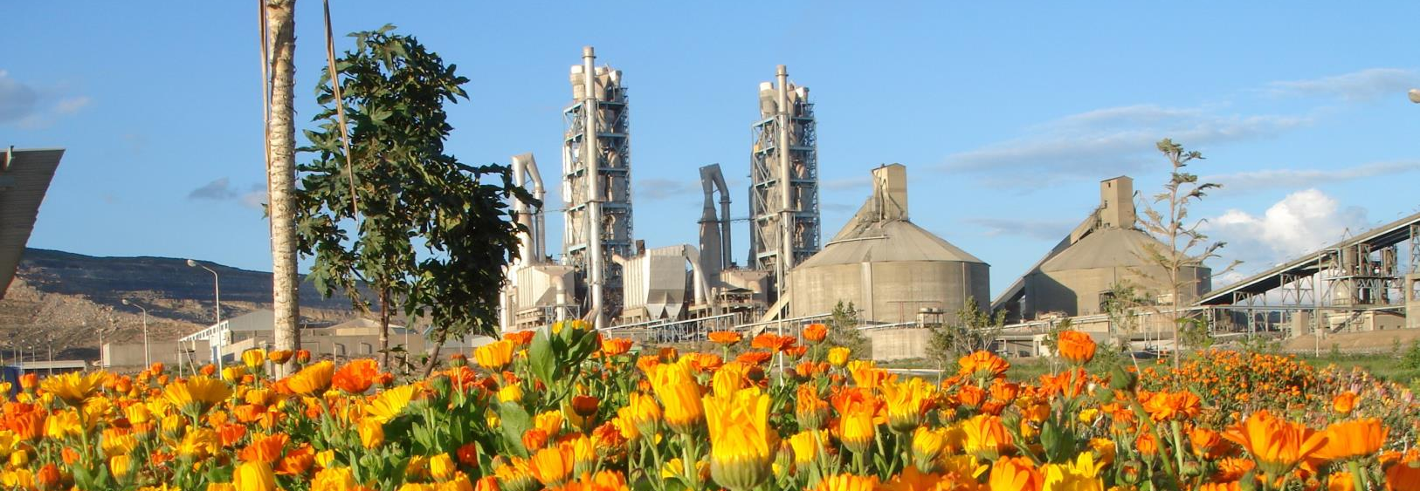
CIP-MEA Safe Preheater Initiative MEA-Quick wins
CIP Middle East Africa
April 22th 2016

Slide 2
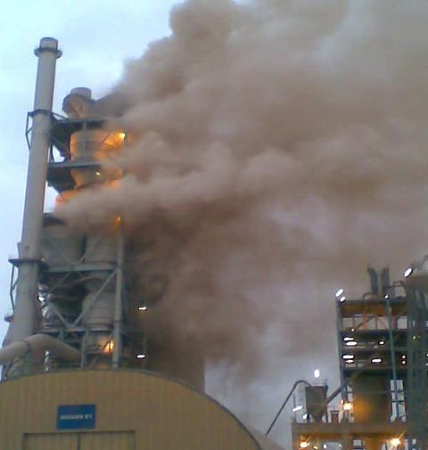
Safe Preheater Initiative Initiative ≥4 LTI in MEA in 2015
Target:
Zero LTI related to hot meal/hot gas
MEA context: increased AF and coke

Slide 3
Safe Pre-heater Initiative MEA Quick wins
Target: Zero LTI related to Hot meal/Hot gas in MEA
SAFE PREHEATER INITIATIVE –
QUICK WINS
Workshop –Gap analysis Tracking tool
Gap analysis- Action plan for each plant
Action Plant Implementation
Closure of the Gap analysis review
Time Frame >>>
End of April End of June End of December End of January
Steps and Tasks
Sharing experience and case studies.
Reference docs and SOPS.
Publish Gap analysis Tracking tool.
Nomination of the Plant champion.
Feed back to CIP round table.
Cluster champions arrange with the Plant Champions each plant visit.
Cluster champion define the gap analysis through the tracking tool with the plant champion.
Plant champion create action plan with plant teams.
Plant management Validate action plan.
Feed back to CIP round table.
Cluster champion review the action plan implementation with plant champion.
Each plant share his case before and after the action plan implementation.
Review of the closure of gap analysis by the CIP-MEA
Feed back to CIP round table

Slide 4
Safe pre-heater Initiative MEA Quick wins
Actions after the Workshop:
Nomination of the Plant champion >>> by end of Process and Production round table end of April- note if no nomination, by default the production manager will be the plant champion.
Cluster champions start the communication with the Plant Champions >>> first week of May, in which the following topics has to be discussed:
Sharing the G-drive for the safe Preheater initiative with the plant champions – discuss the tracking tool for the gap analysis.
Define the visit date of the cluster champion to each plant followed by the logistics of the visit- each visit from 3-5 days.
All the visits of the clusters champions to the plant have to be done before the mid of June ( consider Ramadan will approx. start 6th of June )>>> Mid of June.
The role of the Cluster champion during this visit is to define the gap through the usage of the tracking tool with the support of the plant champion
From the gap analysis , Action plan points will be raised.
The Role of the plant champion is to :
Create the action plant define the resources and time, involve the plant management to validate the AP.>>> 1st week of July.
Implement the action plan >>>> END of Dec 2016.
The Cluster champion review the action plan implementation with plant champion. >>>> END of Dec 2016.

Slide 5
Safe pre-heater Initiative MEA Quick wins-Plant Visits
Clusters - Safe Pre-heater | Country | Plant | kilns | Cluster Champion | total | Plants visits
Africa East Central | KENYA | MOMBASA | 2 | Johnson MACHARIA | 5 | 2 visits -Hima-Mbeya
 | TANZANIA | MBEYA | 1
 | UGANDA | HIMA | 2
Africa South east | SOUTH AFRICA | LICHTENBURG | 2 | Paul Monnagaaratwe | 6 | 3 visits- Chilanga-Ndola-Manresa
 | ZAMBIA | CHILANGA | 1
 | ZAMBIA | NDOLA | 2
 | ZIMBABWE | MANRESA | 1
Algeria | ALGERIA | MEFTAH | 1 | Mustapha Ouhab | 5 | 2visits- Oran (G/W)-Mefta
 | ALGERIA | MSILA | 2
 | ALGERIA | ORAN (Grey) | 1
 | ALGERIA | ORAN (White) | 1
Egypt | EGYPT | EL SOKHNA | 5 | Ahmed AWAD | 5 | No visits
Iraq | IRAQ | BAZIAN | 1 | Mohamed Sardar | 5 | 2visits- Tasluja-Kerbala
 | IRAQ | KERBALA | 2
 | IRAQ | TASLUJA | 2
ME excl Iraq | JORDAN | RASHADIYA | 1 | Georges Henein | 5 | 2 or 3visits- RAS-EMCC-ALS??
 | Lebanon | Chekka | 1
 | Lebanon | Chekka White Cement | 1
ME excl Irak | SAUDI ARABIA | AL SAFWA | 1
ME excl Irak | UEA | EMCC | 1
Morocco | MOROCCO | MEKNES | 2 | Lahcen Boukhsas | 6 | 2 visits- TET-Meknes
 | MOROCCO | BOUSKOURA | 2
 | MOROCCO | TETOUAN 2 | 2
Morocco | Morocco | Oujda | 2 | Khalid Baali | 4 | 2 visits- Fes-Settat
 | Morocco | Fès | 1
 | Morocco | Settat | 1
Nigeria area | BENIN | ONIGBOLO | 1 | Olutayo Odudimu | 7 | 4 visits- ONI-FIG-UNI-ASH
 | CAMEROON | FIGUIL | 1
 | Nigeria | Unicem | 1
 | NIGERIA | EWEKORO II | 1
 | NIGERIA | EWEKORO I | 1
 | NIGERIA | ASHAKA | 2

Slide 6
Safe pre-heater Initiative MEA Quick wins- Gap analysis Tracking tool- Clusters , Plants working sheet.

Slide 7
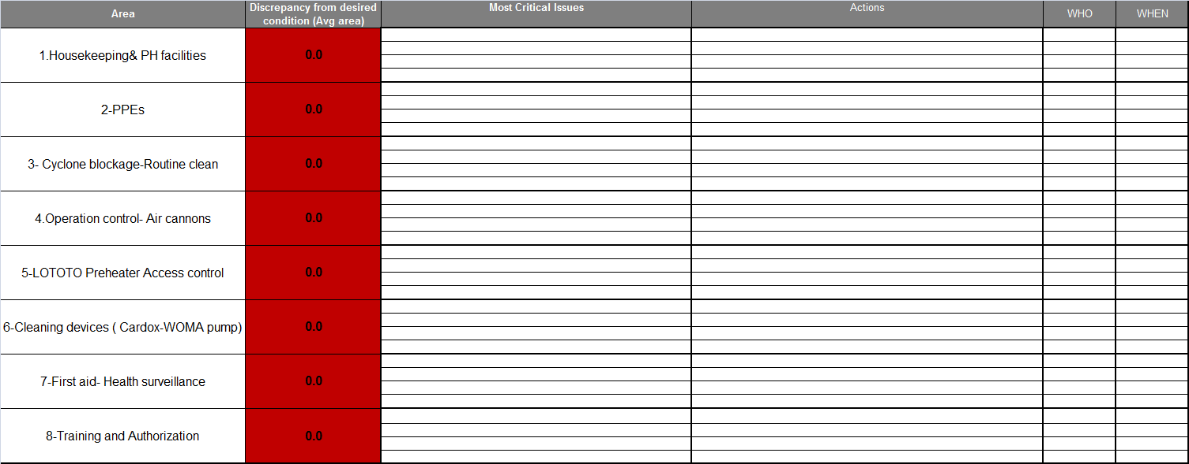
Safe pre-heater Initiative MEA Quick wins- Gap analysis Tracking tool- Global assessment

Slide 8
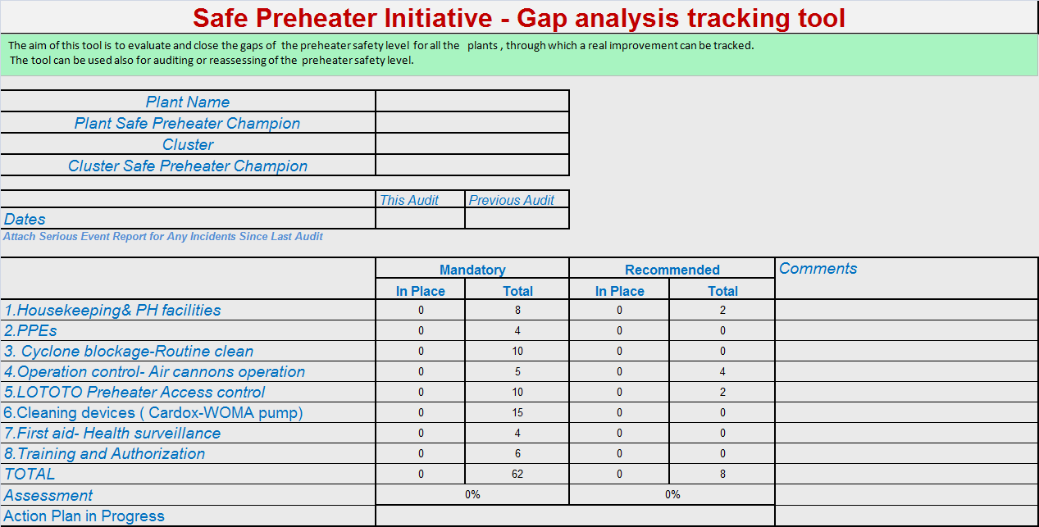
Safe pre-heater Initiative MEA Quick wins- Gap analysis Tracking tool- Summary

Slide 9
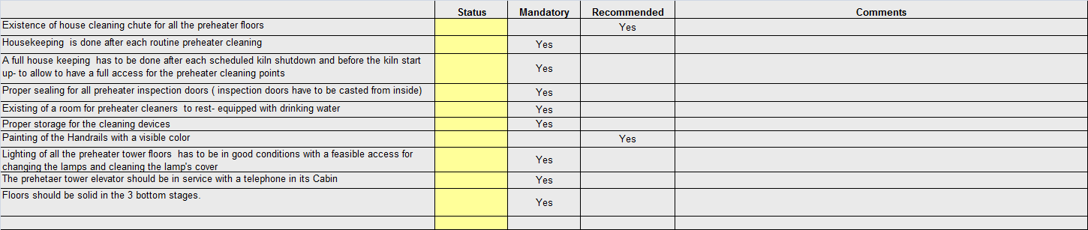
Safe pre-heater Initiative MEA Quick wins- Gap analysis Tracking tool- Housekeeping& PH facilities
Housekeeping in the preheater is a key point for a safe preheater , hot material has to be cleaned by the preheater cleaner after each routine PH clean , accumulation of any foreign materials – bricks , concrete , scaffolding bars ,wood…..etc is forbidden, a free access for all the preheater routine access points has to be confirmed.
After kiln shut down the kiln has to be started with a clean preheater floors- proper PH doors sealing.
PH Cleaning chute in each PH floor will facilitate the housekeeping process.
A suitable preheater cleaner room is importation with a drinking water , a proper place to rest ….
The lighting of the preheater , one of the hidden items , kiln works for 24 hrs!!... , proper light system is basics for a safe PH work in the night , how access the lighting systems has to be accessed.
The PH elevator is a key element for a safe preheater , routine work , emergency, evacuation …….

Slide 10
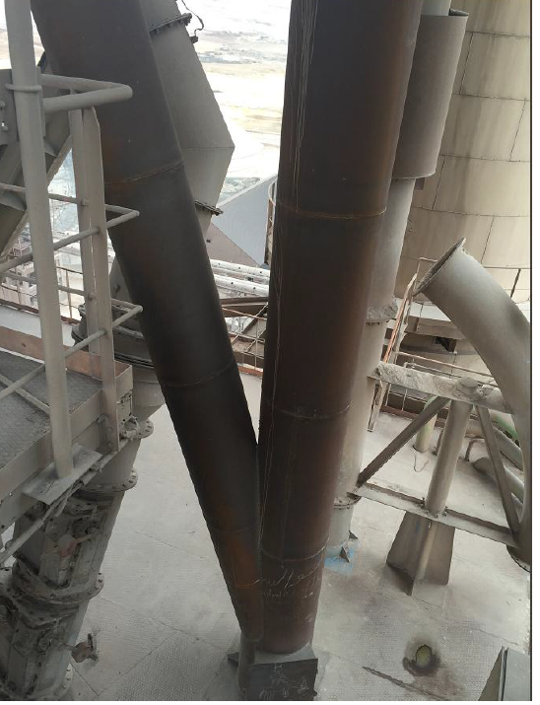
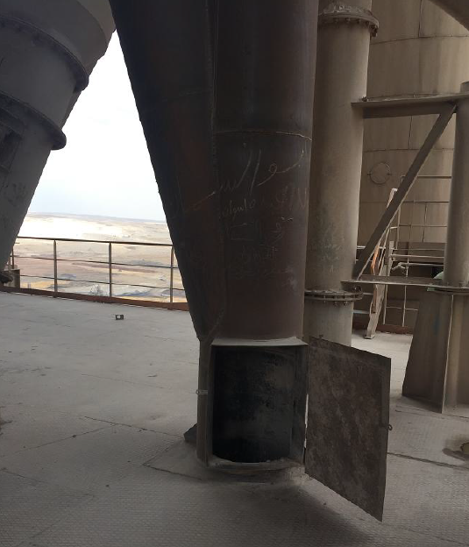
Safe pre-heater Initiative MEA Quick wins- Gap analysis Tracking tool- Housekeeping& PH facilities
Example of PH cleaning chutes -SOK plant

Slide 11
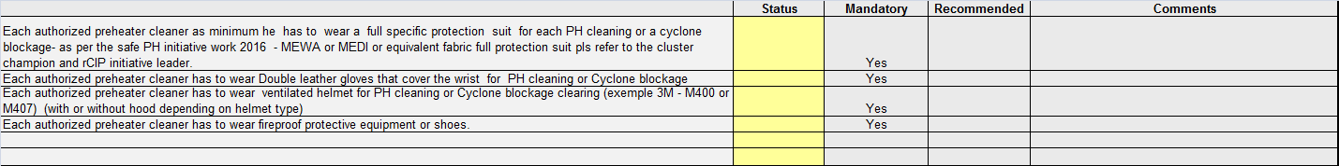
Safe pre-heater Initiative MEA Quick wins- Gap analysis Tracking tool- PPE
A step change is required in the Hot meal PPEs for MEA.
The fabric coverall suit which can resist hot material of 1000 ºC with a better flexibility – ease to work with in a daily basis than the traditional Aluminum suite>>> each authorized preheater cleaner has to have his set.
The ventilated helmet can give a full seal and protection for the cleaner with a ventilation-respiration,>>> each each authorized preheater has to have his own set.
Fireproof protective shoes have to be used for PH cleaners.
A Double leather gloves that cover the wrist has to be used.

Slide 12
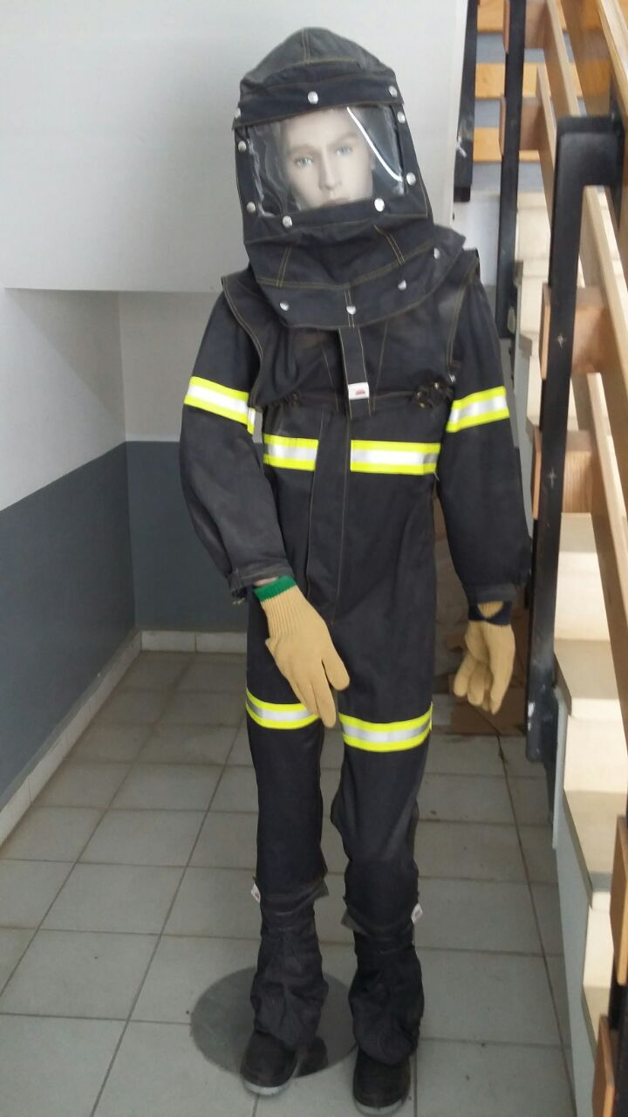
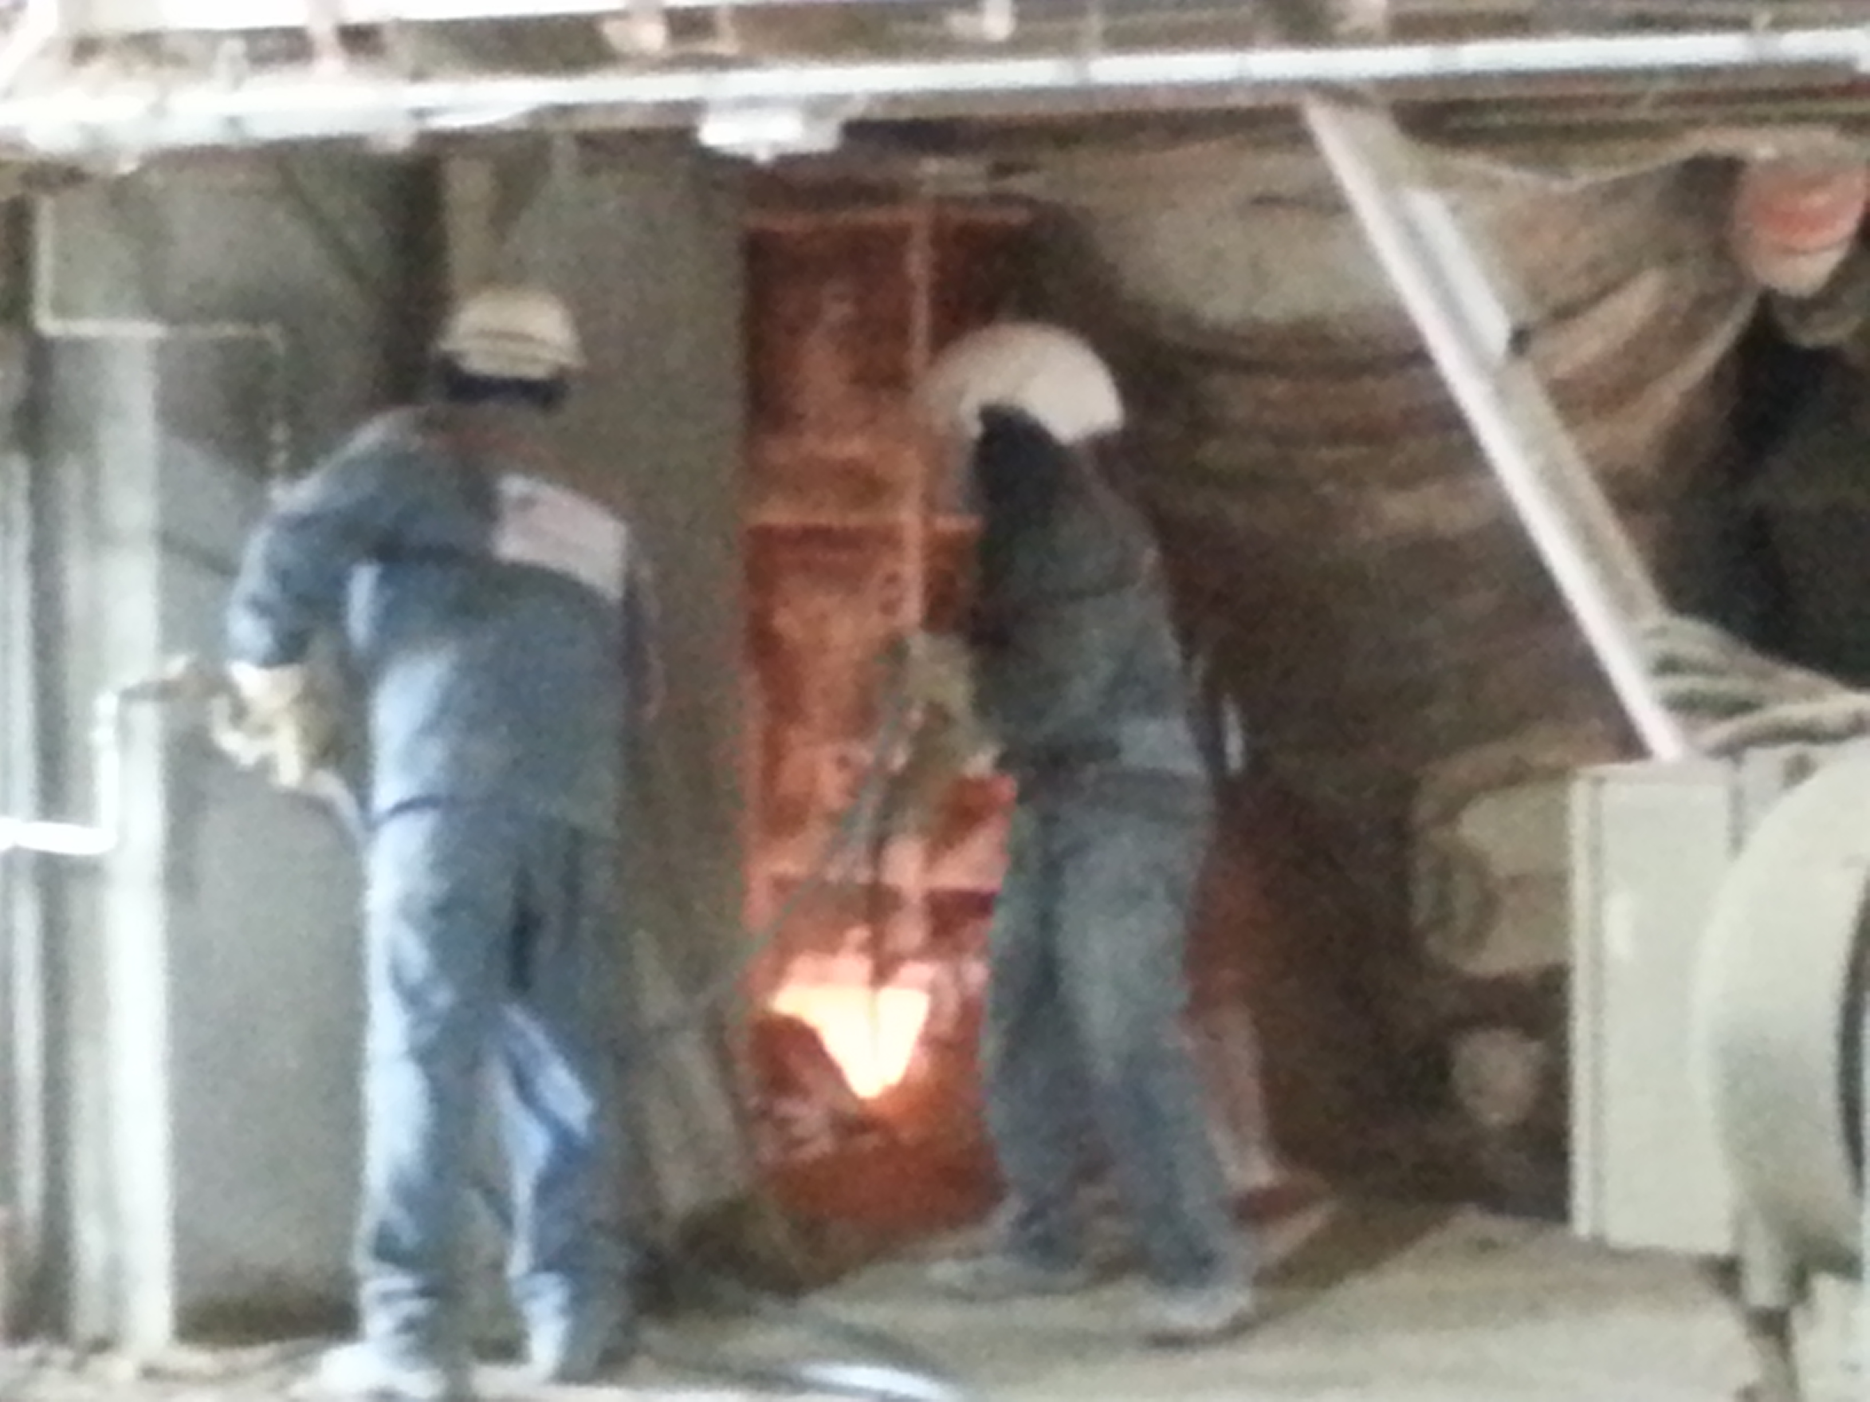
Safe pre-heater Initiative MEA Quick wins- Gap analysis Tracking tool- PPE
Hover: PPEs -MEWA fabric coverall with Ventilated Helmet
MEDI fabric full coverall suit – Chekka plant

Slide 13
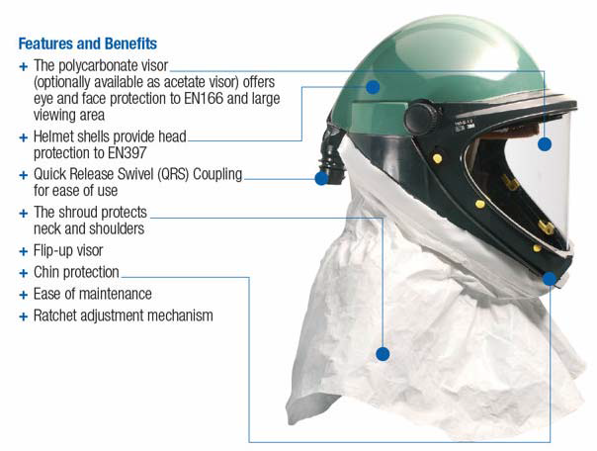
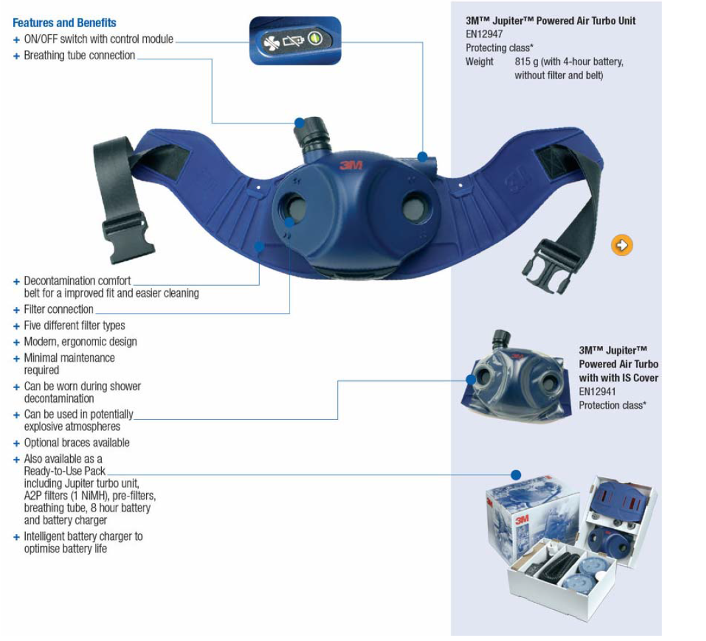
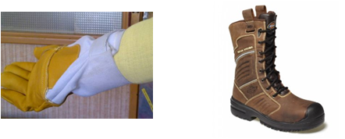
Safe pre-heater Initiative MEA Quick wins- Gap analysis Tracking tool- PPE

Slide 14
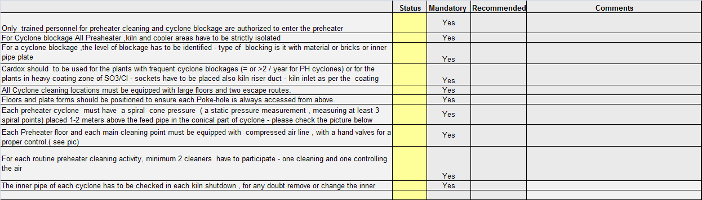
Safe pre-heater Initiative MEA Quick wins- Gap analysis Tracking tool- Cyclone blockage-Routine clean
Its very common that the people injured in a cyclone are not from the preheater cleaner team or Authorized , for example kiln coach , kiln operator….

Slide 15
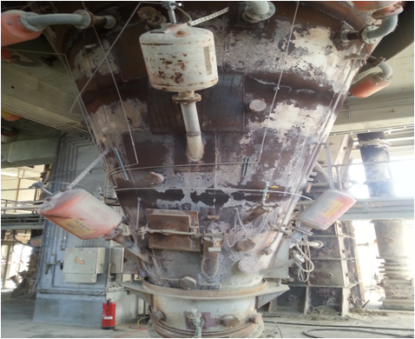
Safe pre-heater Initiative MEA Quick wins- Gap analysis Tracking tool- Cyclone blockage-Routine clean
Isolation of the preheater , kiln and cooler areas are mandatory during cyclone blockage clearing, Once a cyclone blockage is freed , hot meal flows like water and burns like lava.
The usage of Cardox in Cyclone blockage clearance is the one of the safest procedures , no any open of PH …. , for example Hover plant in Hannover , since 2007 no any PH cyclone opening for a cyclone blockage clearence , they are using only Cardox.
The early the detection of cyclone blockage the less is the risk, the spiral cone pressure is the best solution for a fast cyclone detection with an excellent advantages : Fast accurate detection- cheapest solution . It has to be in place for all the preheater cyclones.
A Spiral cone pressure-4 measuring spiral points, 1.5 meter above the feed pipe in the conical part.
Cardox Sockets covering all area of lower cyclone feed pipe
HOVER plant- Lower cyclone 17 blockage in 2015 – 4 hrs max. time of clearing blockage

Slide 16
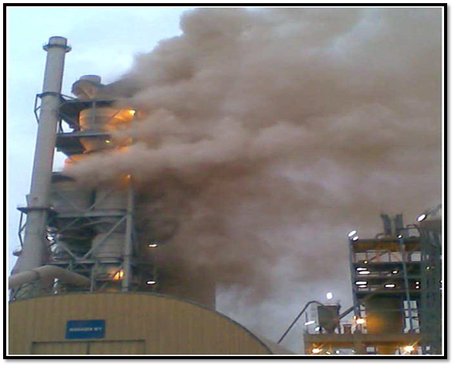
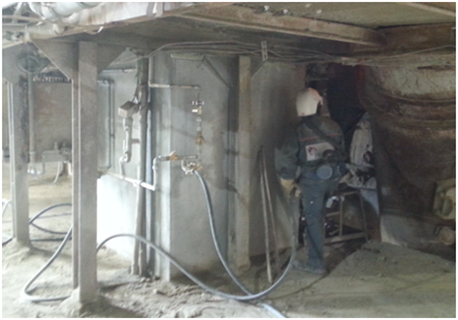
Safe pre-heater Initiative MEA Quick wins- Gap analysis Tracking tool- Cyclone blockage-Routine clean
For a cyclone blockage , one of the first steps is the level of blockage has to be identified - type of blocking, is it with material or bricks or inner pipe plate for the inner pipe of each cyclone has to be checked in each kiln shutdown , for any doubt remove or change the inner pipe >>> remove it before it fall down.
8 injured – Oran-June 2012 – Cyclone 3 blockage by inner pipe- no cone pressure indication – long time before cut the feed.

Slide 17
Safe pre-heater Initiative MEA Quick wins- Gap analysis Tracking tool- Cyclone blockage-Routine clean
Each Preheater floor and each main cleaning point must be equipped with water line and compressed air line , with a hand valves for a proper control
Water and compressed lines very close to the cleaning point.

Slide 18
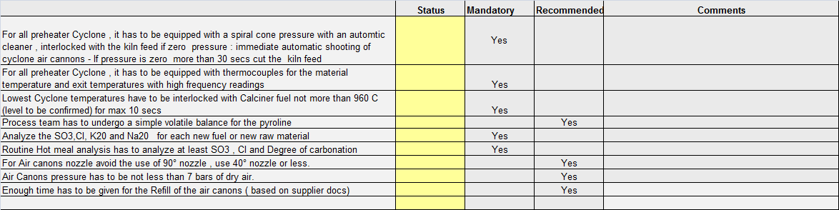
Safe pre-heater Initiative MEA Quick wins- Gap analysis Tracking tool- Operation control- Air cannons operation
Conditions of the interlock of the cone pressure is to have a stable reading which will be a result of : spiral cone pressure with 3/ 4 measuring points AND a proper location in the feed pipe .
Each new fuel or new raw material , analysis of the volatiles and alkalis has to considered.
A simple volatile balance will show where is the plant in the build ups , are the measures taken ( air canons , Cardox, mapping ) or not , is there potential of AF and Petcoke.

Slide 19
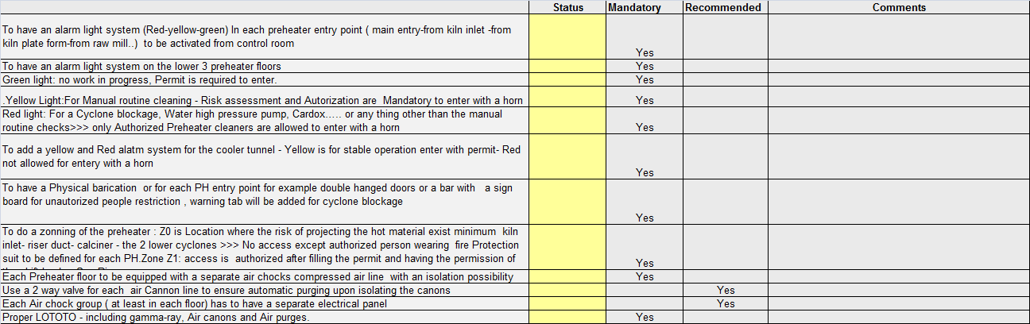
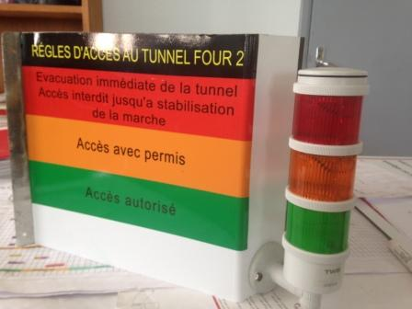
Safe pre-heater Initiative MEA Quick wins- Gap analysis Tracking tool- LOTOTO and Preheater Access control
Preheater light access control-Oujda plant

Slide 20

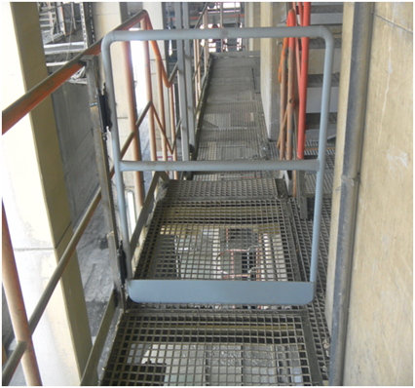
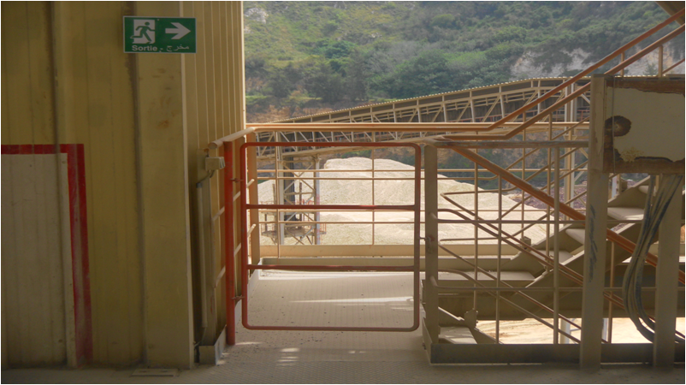
Safe pre-heater Initiative MEA Quick wins- Gap analysis Tracking tool- LOTOTO Preheater Access control
Double direction hinged doors plus a sign board for unauthorized people restriction- Incase routine cleaning of PH, cyclone blockage, WOMA, Cardox isolate the access doors by means of warning tapes
Pad lock ability these locked doors can restrict the access in case of an emergency on the preheater
CHEKKA PLANT EXPERIENCE

Slide 21
Safe pre-heater Initiative MEA Quick wins- Gap analysis Tracking tool- LOTOTO Preheater Access control-Zoning of PH
The zoning of the preheater is done in analogy with the ATEX zoning :
Terminology of ATEX |  | Teminology of Preheater
Zones | Defination | Zones | Definition
Z20 | An area in which an explosive mixture is continuously present or present for long periods | Z0 | Location where the risk of projecting the hot material is permanently or for long periods or frequently or short (normal and abnormal operation).
Z21 | An area in which an explosive mixture is likely to occur in normal operation
Z22 | An area in which an explosive mixture is not likely to occur in normal operation and if it occurs it will exist only for a short time. | Z1 | Location where the risk of projecting the hot material is zero or the existence of effective protection in this area.
FES plant example

Slide 22
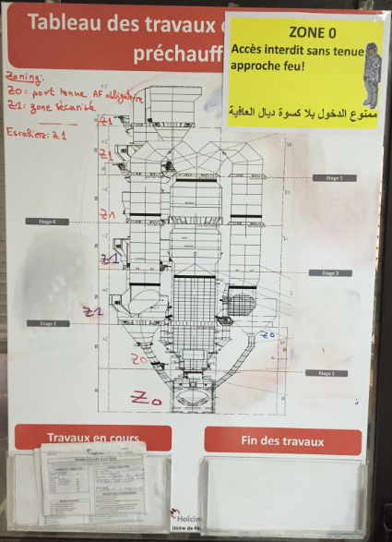
Safe pre-heater Initiative MEA Quick wins- Gap analysis Tracking tool- LOTOTO Preheater Access control-Zoning of PH
The Shift leader is filling zoning informations on the board :
Zone Z0: No access except authorized person wearing fire Protection suit.
Zone Z1: access is authorized after filling the permit and having the permission of the shift leader.
FES plant example

Slide 23
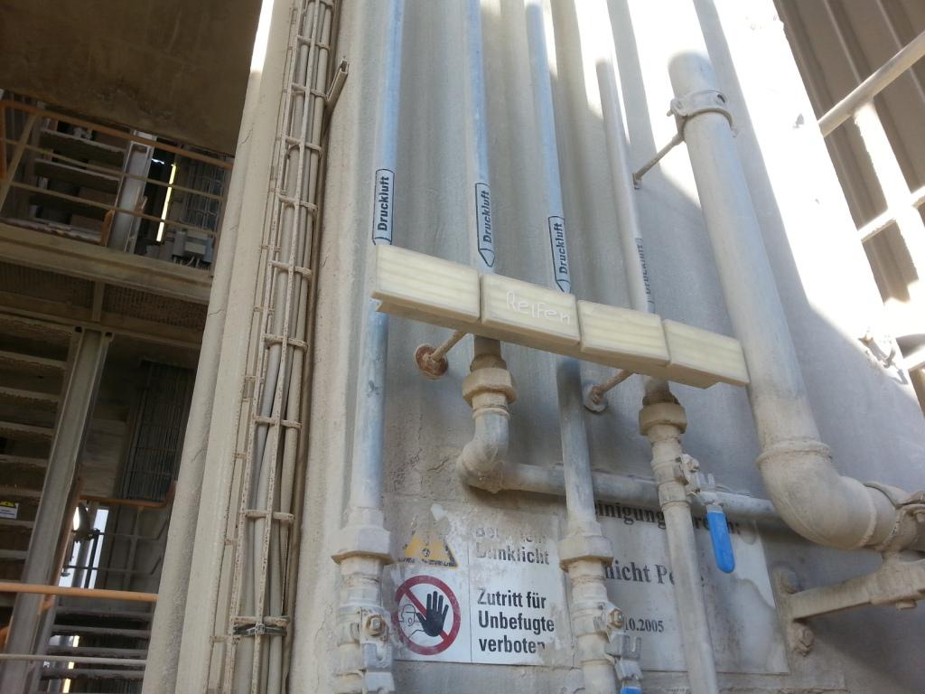
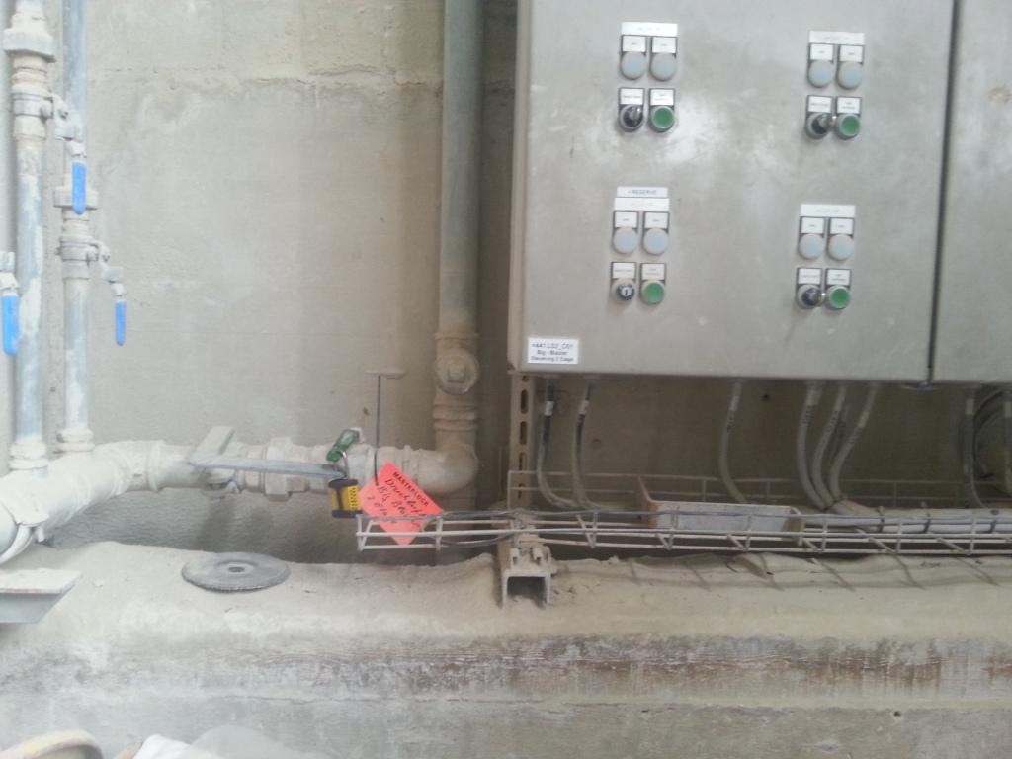
Safe pre-heater Initiative MEA Quick wins- Gap analysis Tracking tool- LOTOTO and Preheater Access control
Each PH cleaning area or floor has separated air line service .
Hover plant LOTOTO example , locking the air service , empty the air chocks and isolate the electrical cabin.

Slide 24
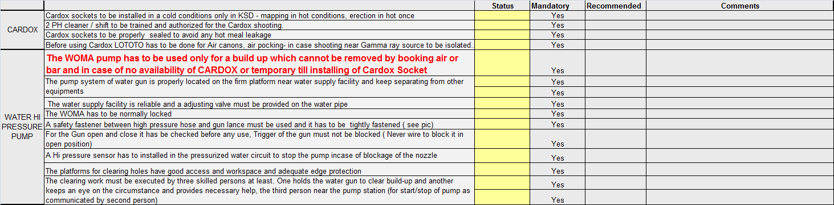
Safe pre-heater Initiative MEA Quick wins- Gap analysis Tracking tool- Cleaning Devices Cardox-Water Hi pressure pump (WOMA pump)

Slide 25
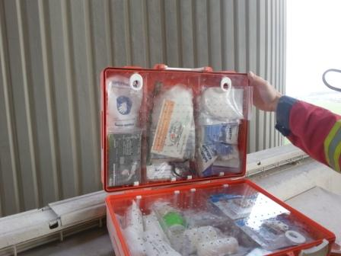
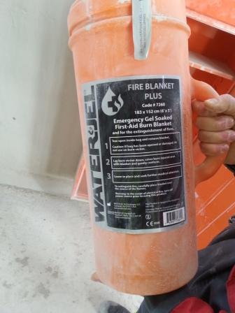
Safe pre-heater Initiative MEA Quick wins- Gap analysis Tracking tool- First aid- Health surveillance
Hover : First Aid box in each floor- monthly inspected
Hover: Fire cooling blanket in each floor

Slide 26
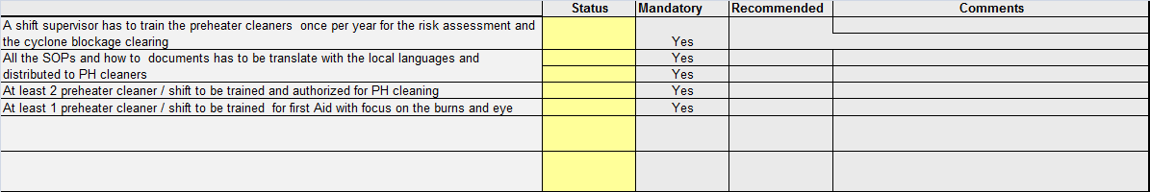
Safe pre-heater Initiative MEA Quick wins- Gap analysis Tracking tool- Training and Authorization
Finally, the most efficient way to control the risks is to understand it, thus working on the mind-set of the people remain the biggest and main challenge

Slide 27


